Slide 1
UNIT 5
Compensation management

Slide 2
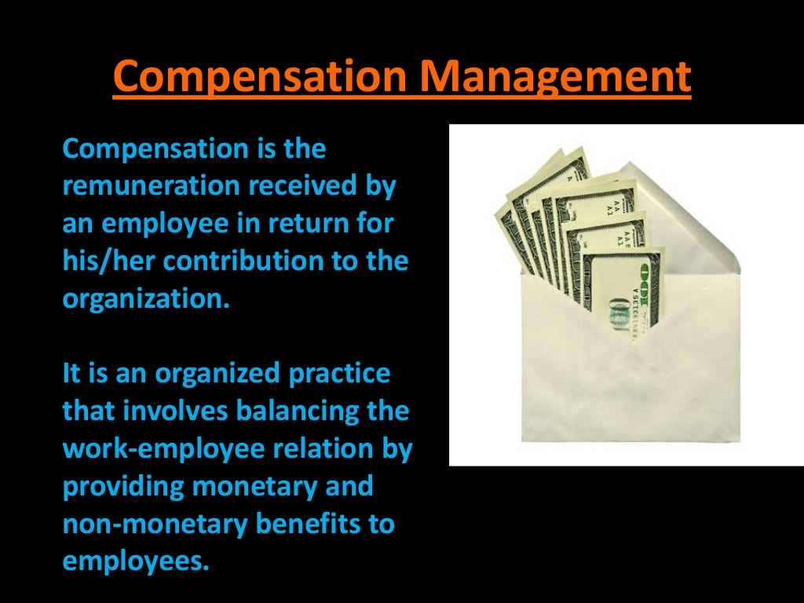
3
2 of 16

Slide 3
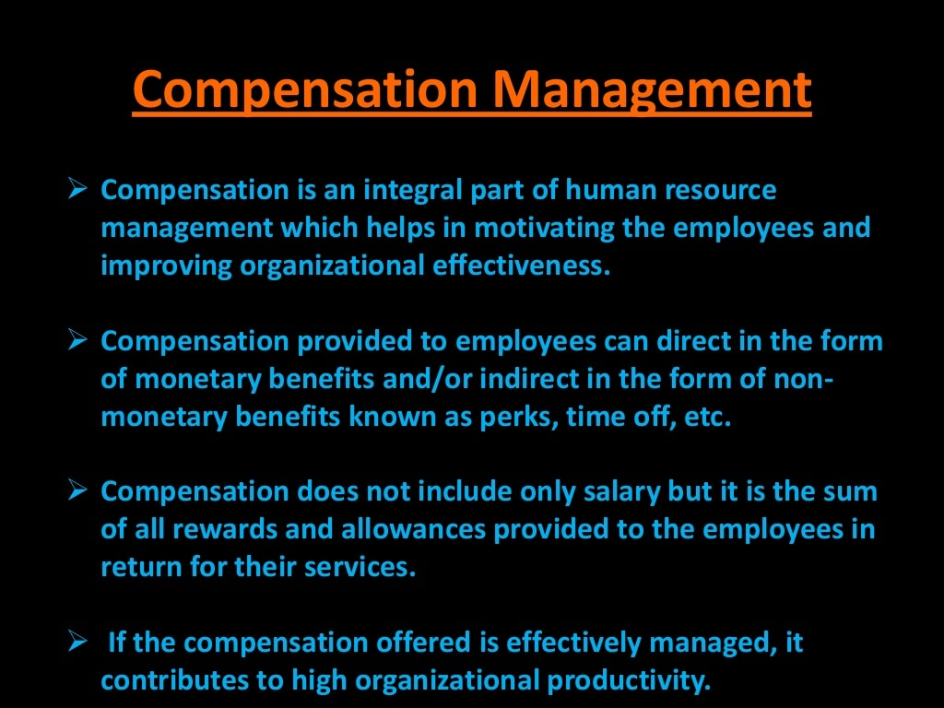
3 of 16

Slide 4
“compensation is the activity by which organization evaluate the contributions of employees in order to distribute fairly direct and indirect monetary and non-monetary rewards within the organizations ability to pay the legal regulations” R.S .Schuler

Slide 5
Compensation Management: concept
“Compensation refers to all forms of pay or rewards going to employees and arising from their employment.” Thomas Patten Jr.

Slide 6
conclusion
Compensation is composed of money received in the performance of work , plus the many kinds of benefits and services that organizations provide to their employees.

Slide 7
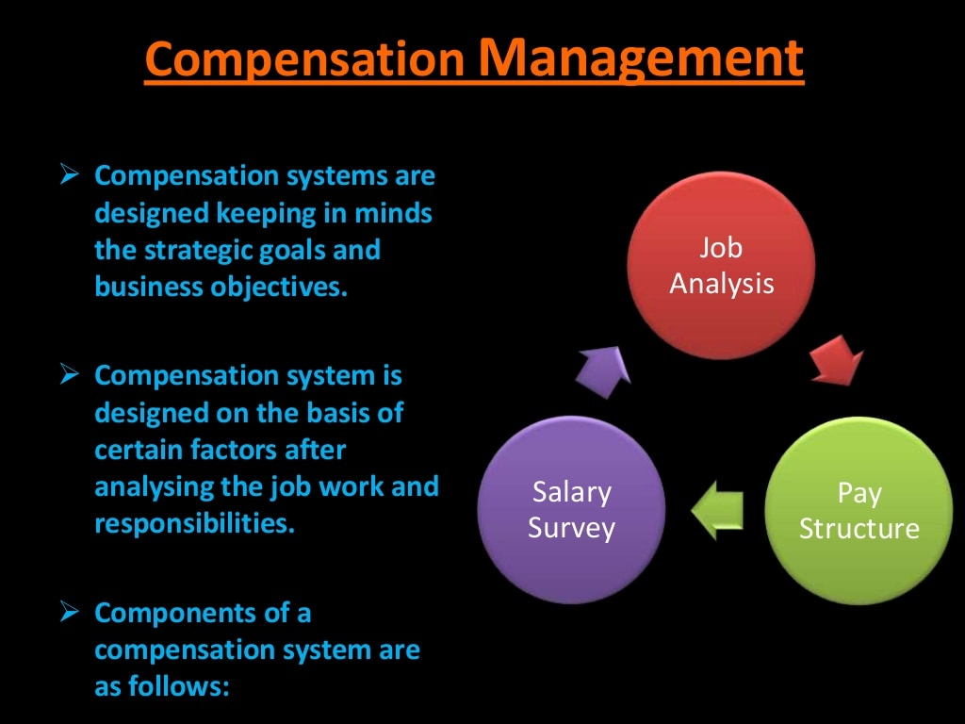

Slide 8
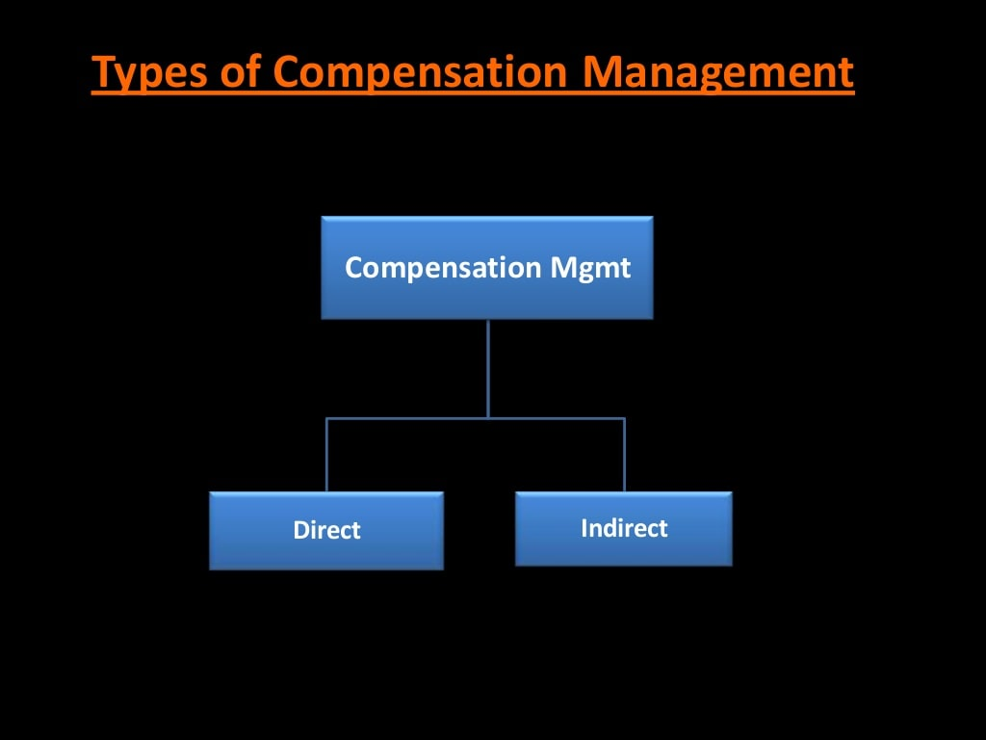
Compensation Management
1
5 of 16

Slide 9
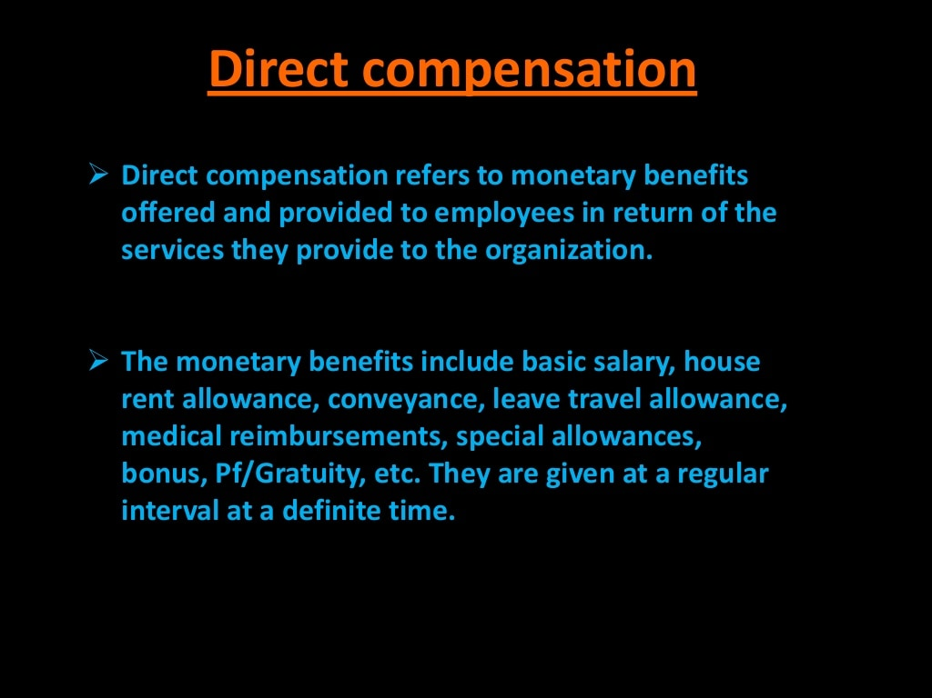
Compensation Management
1
6 of 16

Slide 10
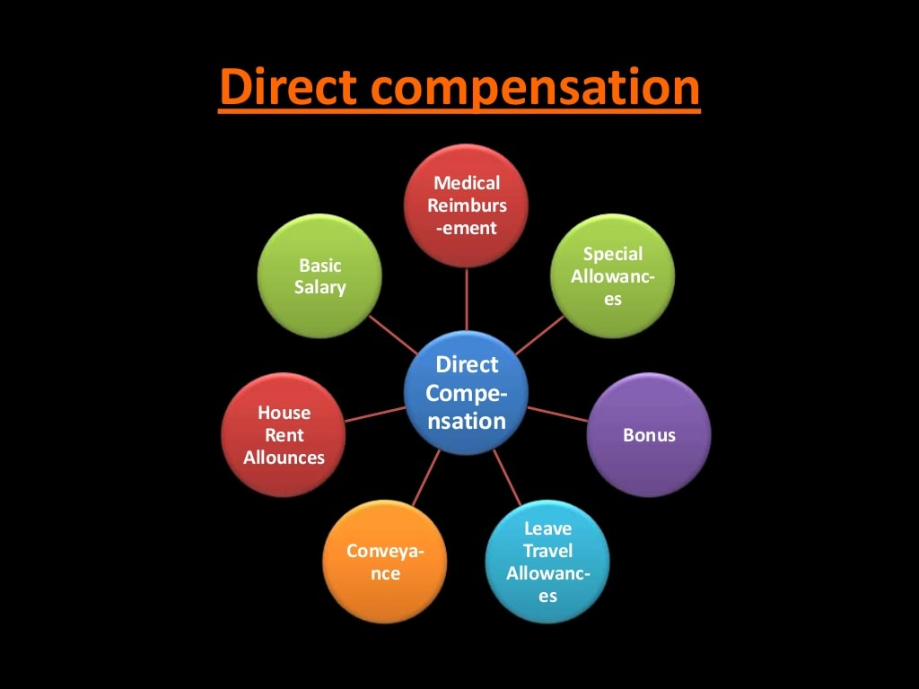
Compensation Management
1
7 of 16

Slide 11
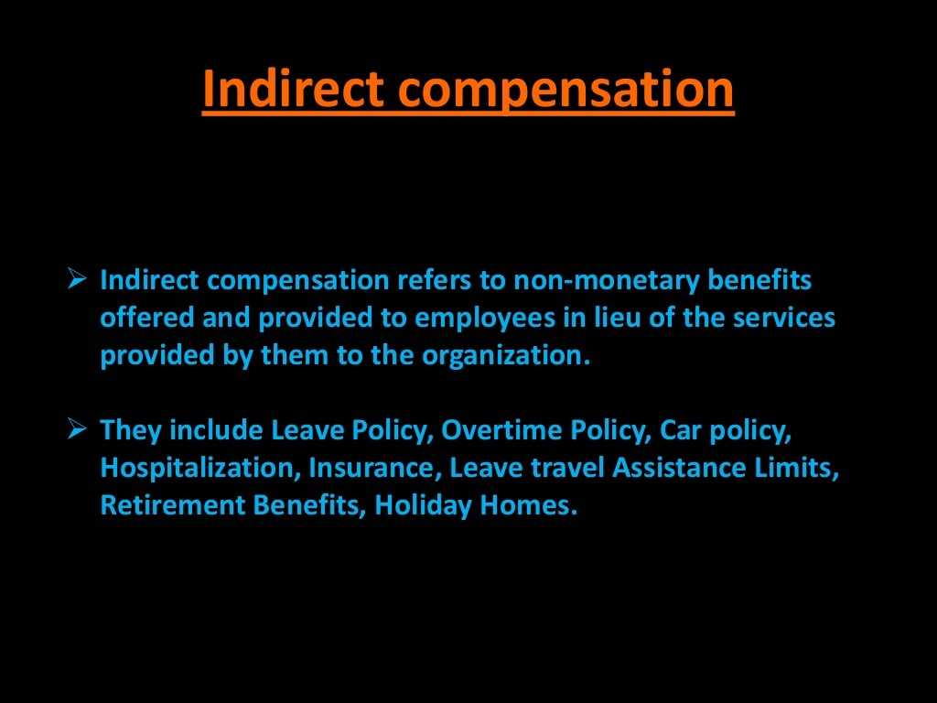
Compensation Management
8 of 16

Slide 12
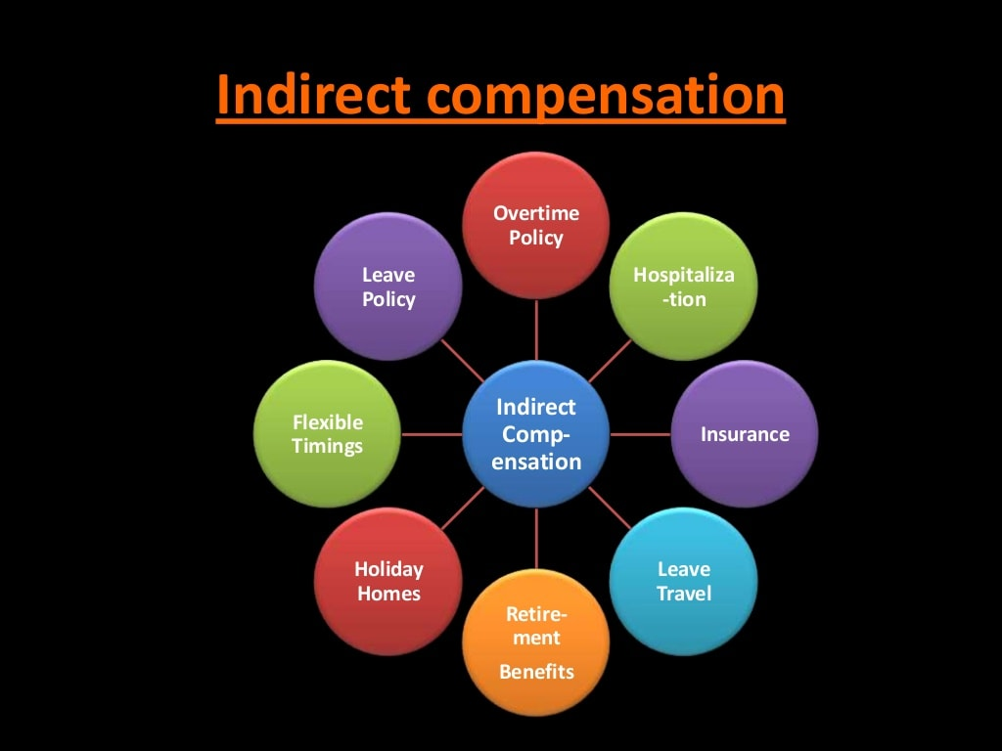
Compensation Management
1
9 of 16

Slide 13
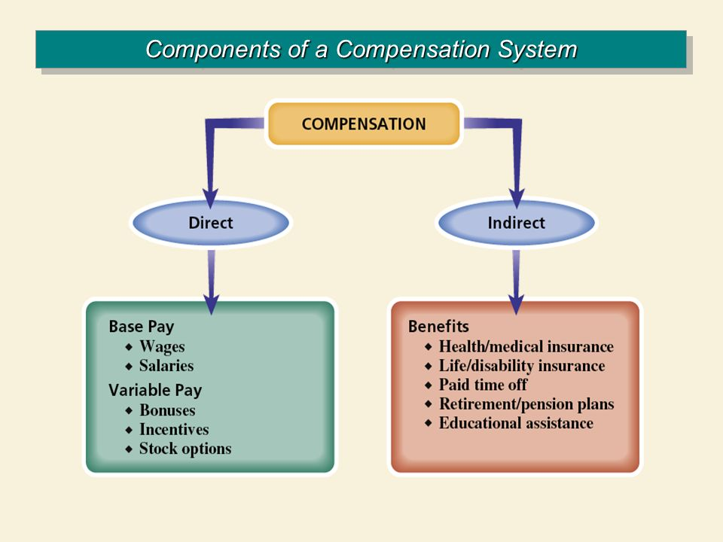

Slide 14
Wage and salary : wage is the remuneration paid periodically to an employee or worker . wages usually refer to the hourly rate paid to such groups as production and maintenance employees(I . e. blue collar workers).
On the other hand salary refers to the weekly or monthly rates paid to clerical, administrative and professional employees(I .e. white collar workers).
2. Incentives : it refers to all the plans that provide extra pay for extra performance in addition to regular salary and wages.

Slide 15
3.benefits: they are usually known as ‘fringe benefits’ because they are offered by the employer to the employee as a fringe (free of cost). The term covers a number of benefits like:
Pay for time not worked (holidays,leaves,paid vacation etc.)
Protection programs(insurance , pension etc.)
Executive benefits(telephone , security guards , newspapers etc.)
4.Services and perquisites : organization also provide a number of services that employees find desirable. These services are provided by the organization at no cost to the employee .
These services include :
work clothing,transportation facilities,child care facilities financial and legal services educational ,medical, outplacement services etc.

Slide 16
Structure and components of compensation
Total compensation
Intrinsic rewards (job factors)
Extrinsic rewards (monetary)
Indirect compensation
Pay for time not worked
Direct compensation
Protection programs
Employee services and perquisites
Basic wages
Performance based pay

Slide 17
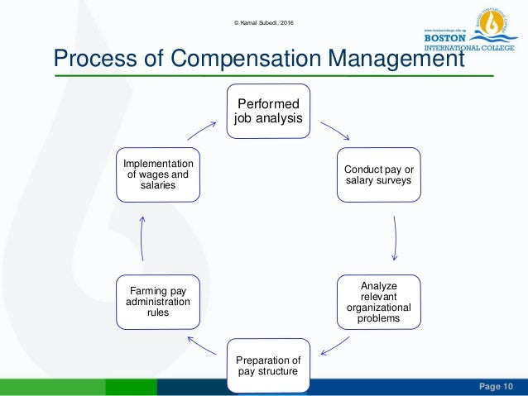
Process of compensation management (The pay determination process)

Slide 18
Process of compensation management( the pay determination process)
Performing job analysis
Conducting pay(wage/salary)surveys
benchmark jobs packaged surveys own surveys
3.Analysis of organizational problems
4.Preparation of pay structure
5.Framing pay administration rules
6.Implimentation of wage and salaries

Slide 19
1. Performing Job Analysis:
Job analysis has two major outcomes vía, job description and job specification. After that, evaluating or rating of the job occurs. A job is evaluated to its value relative to all other jobs in the organization which involves converting the relative job values into specific monetary values.

Slide 20
2. Conducting Pay (Wage/Salary) Surveys:
In this step the actual amount of money to be paid is determined through wage and salary surveys. The objectives of pay survey are to seek answers to the following important questions:
How much other firms are paying?.
What are the items included in social security?
What is the level of pay offered by other firms for similar jobs?
Benchmark jobs: Based on the relative price of these jobs, other jobs are compared to determine the relative pay scales accordingly. These jobs are usually known as good indicators.
Packaged surveys: These surveys are readily available from the research agencies.
Own surveys: Big companies also go through their own surveys for the purpose of pay structure.

Slide 21
3. Analysis of Organizational Problems:
Determination of pay requires more than wage and salary surveys. Dozens of variables can affect wage structure. HR managers maybe interested in following queries: .
What should be the relationship between the pay structure and fringe benefits?
Would the firm recruit new employees after revised pay structure evaluation?
Are the prevailing rates in industry consistent with the result of job evaluation?
What will be the result of paying higher or lower compensation and so on?

Slide 22
4. Preparation of Pay Structure:
It is the joint outcome of above three steps. For the purpose of determining pay structure a lot of decisions need to be taken. For example :
Whether to pay amounts equal, above or below the industry level?
Whether there should be single rates? Or, whether pay ranges should provide former it increases?
The number of width of pay grades and the extent of overlap.
Which jobs are to be placed in each of the pay grades?
The actual money value to be assigned to various pay grades. Differentials between pay plans etc.
Conclusions: In reality, there are no hard and fast rules for making such decisions.

Slide 23
5. Framing Pay Administration Rules:
As the rate ranges have been determined, the development of rules/policies of pay system has to be fixed. A lot of policies and rules are required to answer the following issues:.
A trade off between seniority and merit basis.
The frequency of pay increases.
How to control salary and wage costs.
Other important activities are:
The employees are to be informed of the details of pay program.
Transparency vs. secrecy (secrecy may create dissatisfaction and negative attitude).
The job is appraised and pay is fixed for the grade.

Slide 24
6. Implementation of Wages and Salaries:
Finally, it should be implemented and controlled by authorized executives. Due to the sensitivity of pay system, it is usually assigned to a committee composed of high-ranking officers for frequent advice and help from technical/HR staff which may review the whole implementation process. HR department must ensure the compliance with the established rules, policies and pay structures.

Slide 25
Determinants of pay structure
External factors
Labour market(demand and supply of labour)
Internal factors
Organizations ability to pay
Prevailing wages
Cost of living
Trade unions bargaining power
Job requirements
Government laws
productivity
Managerial attitudes

Slide 26
Methods of Employee Compensation
There are various methods of compensation available in HRM practice. Some of the popular methods are:
Base plus cost of living allowance (BCOLA):
This method is based on two factors ie. base and allowance. Every organization has their base salary for all the types of jobs. On and above that employees are provided with cost of living allowance. COLA is an adjustment to the base salary by a percentage that is assumed to match increases in for goods and services. It is based on a national , regional or local level or account for changes in the market.

Slide 27
2. Scale plus cost of living allowance (SCOLA):
This is the second method of compensation used by many organizations. It also has two components viz. scale level for a particular level of job plus the COLA given. Many companies set a range of pay rates, from minimum to maximum, designed for specific pay grade. On and above that a cost of living adjustment/allowance (COLA) is given to the employees as discussed in first methods.

Slide 28
Cash incentives:
This is the third method used in compensation. This method takes one of the two methods explained above. Again, the employee is given, additional compensation to motivate and reward him/her for exceeding performance goals in the form of cash incentives.

Slide 29
4. Bonus or variable pay:
It is another method that is used by many of the organizations. It is used to compensate their employee according to their contributions. Bonus or variable pay plan (method) is an incentive pay plan which awards employees compensation, in addition to their base salary. It is given for achieving, individual or group performance and productivity goals.

Slide 30
5. Broad banding method:
Broad banding means collapsing salary grades and ranges into just a few wide levels (or bands). Each of band contains a wide range of jobs and salary levels. It creates vertical pay rate range. For example, government of Nepal's pay plan consists of 9 main grades (class less 3+Non-officers 2+officers 4-9), each with its pay range. There are three broad bands viz; classless, non-officers, officers. For employees whose job falls in one of these grades, the pay range for that grate decides his/her minimum and maximum salary.

Slide 31
6. Job or skill based pay method:
It is another type of compensation method which is becoming very popular in recent years. It may be due to high demand for skills, experience, and education trend in the market. In a real sense it is a salary differentiation system that bases compensation on an individual's educations, experience, knowledge, skills or specialized training.

Slide 32
7. Merit pay method:
It is also a very popular method of compensation used by majority of organizations in recent days. Merit pay is a compensation system where by base pay increases are determined by individual performance.

Slide 33
Other forms of compensation:
These techniques are only supplementary in nature than an established method. Some examples are: awards programs, sabbaticals, team based pay and so on.

Slide 34
Job evaluation
Job evaluation is a systematic way of determining the value/worth of a job in relation to the other jobs in an organization. It tries to make a systematic comparison between jobs to assess their relative worth for the purpose of establishing a rational pay structure.
Job analysis is systematic way of gathering information about a job.
Job evaluation process
Preliminary process
Selecting a job evaluation
Developing the plan
Evaluating jobs

Slide 35
Preliminary planning:
In it, the first issue is whether to conduct job evaluation formally or informally. The formal evaluation is relatively systematic application of standards and decision rules to rank or rate jobs. It is longer and costly process. Informal evaluation is opposite to it.

Slide 36
2. Selecting a job evaluation plan (methods):
For this purpose, four common job evaluation methods are available viz., ranking, classification, factor comparison, and point. The point method is basically the most widely used method (for details see methods of job evaluation topic).

Slide 37
3. Developing the plan:
In this third step, a job hierarchy is developed by comparing the content of various jobs against specified standards using a predetermined procedure.
4. Evaluating jobs:
Jobs cannot be adequately evaluated without accurate, up-to-date information about job duties and responsibilities. Very often of the job evaluation committee also observe the job and interview (i) jobholders and (ii) supervisors to obtain additional information for the evaluation.

Slide 38
Methods of Job Evaluation
Non Analytical
Ranking Method
Job-grading Method
Analytical
Point Rating Method
Factor comparison Method

Slide 39
Ranking Method
According to this method of Job evaluation, jobs are arranged from highest to lowest, in order to their value or merit in the organization.
Jobs can also be arranged according to the relative difficulty in performing them.
The jobs at the top of the list has the highest value and the job at the bottom lowest value.
Jobs are usually ranked in each department and then departmental rankings are combined to develop an organizational ranking.

Slide 40
Job-grading or job-classification Method
A predetermined number of job groups or job classes are established and jobs are assigned to these classifications.
The essential requirement of this method is to frame grade description to cover discernible difference in degree of skill, responsibility and other job characteristics.
Job grades or classes are arranged in the order of their importance in the form of a schedule.

Slide 41
Point Rating Method
The system starts with the selection of key job factors, construction of degrees of each factor, and assignment of points to each degree.
The points are summed up to determine the wage rate of the job.
Grades and wages are predetermined in accordance with the range of points - for example from 210 to 230 points, the 5th grade and daily wage rate 300-400.
Jobs with similar points are placed in similar pay grades.

Slide 42
Factor Comparison Method
It is a more systematic and scientific method of job evaluation.
Under this method, instead of ranking complete job, each factor of job is ranked individually with other jobs.
Usually these factors include - mental requirements, skill requirements, physical exertion, responsibility, and working condition etc.
according to this method pay will be assigned by comparing the weights of the factors required for this job, in other words, pays are assigned to the job in comparison to its ranking on each job factor.

Slide 43

Employee benefits: Incentives system(tools of PBP)
In the words of scott,” incentives pay is any formal and announced program under which the income of an individuals, a small group, a plant work force or all the employees of a firm are partially or wholly related to some measures of productivity output”

Slide 44
A. Developing incentives plan (system)
The basis process involved in developing an Individual or group pay plan is as follows:
1.Establishing minimum job rates.
2. Establish performance standards.
3. Determine incentives rates.
4. Establish process for changing standards.
5.Try out the incentives plan on an experimental basis.
6. Communicate and implement the plan.

Slide 45
B. Types of incentives pay plan(IPPs)
Individual level incentives plans: people are pay- off for individual performance. There are several individual level incentives plans. Important types are:
The piecework plan. (F.W. Taylor)
The standard hour plan. (time per unit of output rather then money per unit of output)
Sales incentives plans.
Managerial incentives plans.

Slide 46

2.Group level incentives plan
It is the plan in which a production standards is set for a specific work group and its members are paid incentives if the group exceeds the production standards. The reason beside the birth of group incentives plan is the organizations are becoming larger and complex and jobs are becoming interdependent to each other. there are various ways to implement the group incentives plan:
a. Production incentives plan
b. Department head incentives program
c. Professional incentives programs.

Slide 47

3. Organizational level incentives plan
Sometimes group level incentives plans do not work properly .Therefore the conditions demand for the other type plan such as organizational incentive plans. The objectives of the plans is to direct the efforts of all employees toward overall organizational productivity or effectiveness. Important plan in this category are:
Profit sharing plans
The Scanlon plan (employee-employer participation and sharing in the operation and profitability of the company)
Gain sharing plans (reward employees for improvements in organizational productivity)
Employee stock ownership plan

Slide 48
4. Employee Stock Ownership Plan (ESOP)
A firm annually contributes its own stock-or cash (with a limit of 15% of compensation) to be used to purchase the stock-to a trust established for the employees.
The trust holds the stock in individual employee accounts and distributes it to employees upon separation from the firm if the employee has worked long enough to earn ownership of the stock.

Slide 49
Employee Benefits and Services
Concept
Indirect and non-cash compensation paid to employee by the employing organization is called "benefits". Some benefits are mandatory (made compulsory) by law (such as social security, unemployment compensation, etc.). Voluntary incentives differ from organization to organization or industry to industry. Examples of them are health insurance, life insurance, medical plan, paid .
Business Dictionary.com: "In general, non-direct and non-cash compensation paid to an employee is called employee benefits.
Wikipedia: "Employee benefits and benefits in kind include various types of non-wage compensation provided to employees in addition to their normal wages or salaries."

Slide 50
2. Types of Benefits
Benefits are classified by different organizations in different ways. A simple and easy way tom classify them is as follows:
Economic/financial services: They are intended to provide financial assistance to the employee and their families. They are given especially in time of sickness, accidents, old age, and unemployment, etc.
Recreational/social services: They aim to provide employees with opportunities for the fruitful use of their leisure hours. Examples are: hiking, fishing, hunting, biking, social services, games, swimming, etc.

Slide 51
3. Professional services: This is offered by the professional staff of the company because employees generally can't afford to pay these services outside. Examples are(a) counseling services, (b) legal advice (c) education and self development activities , etc.
4. Family welfare services: These are the services given for employee's family welfare and convenience. Examples of it are: physical and mental health checks-ups, family planning, sports, foods, etc. They are given also to family members not only to the individual employee alone.

Slide 52

Incentives for Management
• Short-Term Incentives: The Annual Bonus
Plans that are designed to motivate short-term performance of managers and are tied to company profitability.
Issues in Awarding Bonuses
Eligibility basis
Fund size basis
Individual awards

Slide 53
Government regulations of compensation in Nepal.
Legal environment pay system governance in Nepal (In general ) is not satisfactory enough. There are three component to be discussed:
1. The legal environment :
Government legislation related to pay plays a vital role in determining pay structure practice of an enterprise . Important acts directly or indirectly related to pay system in Nepal are:
Labour act 2048 and labour regulation .
Bonus act.
Public service regulation.
Company act 1996.
Interim constitution of Nepal 2063.

Slide 54
2. Pay system governance .(institutional framework )
To implement the pay policy , regulations and directives government has formulated Institutional framework . Some important bodies are:
Department of labour (DOL): implement pay policy of GON
Wage boards: determine minimum wages.
Pay commission / committee: conduct pay survey and provide suggestion to revise existing pay levels
Tribunals: manage pay dispute
Labour court: settle disputes regarding pay or compensation.

Slide 55
3. Pay practices in Nepal
Pay practices in Nepal differ according to the nature of the organization, Management philosophy ,legal provisions , productivity and union pressure among others , they are :
Government organization (GOs): strictly follow the rules and regulations developed by government. Low salary and incentives. Benefits and services are higher as compare to private organization.
Private sector organization.(PSOs): general pay level is not satisfactory.
Private bank and financial institution: comparatively good pay for higher level.
Non government organization.(NGOs): some NGOs provide a bit higher salary then Gos but they do not offer long term benefits and services.

Slide 56
4. Provisions relating to minimum wages.
Most of the problems in industrial relations in Nepal come from wages issues a studies of the cause of industrial disputes in Nepal occurred due to worker dissatisfaction with wages and fringe benefits .
In Nepal state intervention in wages determination began in 1965.
The wages structure was revised in 1973 and the structure was further revised in 1977.
The Dearness Allowance (DA) is a cost of living adjustment allowance paid to Government employees, Public sector employees (PSU)and pensioners

Slide 57
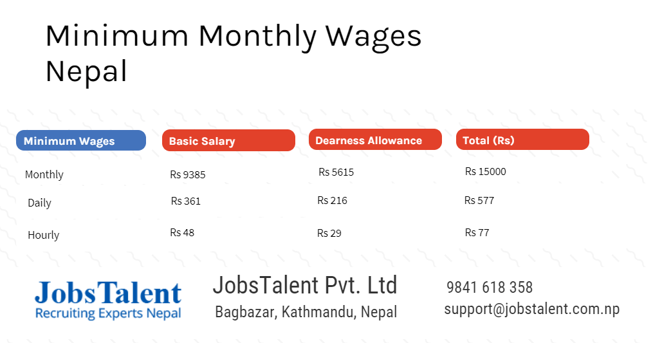

Slide 58
5. Social welfare factors in Nepalese acts.
Concept :
Social welfare or security includes the creation of family responsibility of the organization. through those methods organization / state tries to covers:
Medical care in time of illness
Maternity facilities and cash allowances in case for female employees .
Pension during inability .
Pension in old age after retirement
Payment of funeral expenses
Unemployment or layoff allowance .

Slide 59
2. Provisions in Nepalese act
a. Civil service act 2049(1993)
Employee provided fund
Festival expenses and other facilities
Gratuity
Pension
Special economic facility
Leaves etc:
b. Labour acts 2048(1992)
Provision relating to health and safety .
Welfare provisions, compensation , welfare funds , leaves etc
3. Social security
Purpose
Coverage
Insurance and contribution
Various benefits

Slide 60
Retirement Benefits
Retirement and pension benefits are given to a retired government official to make sure that they have a constant income and a secured life. The pension provisions are in place to ensure that the retired government officials are well off and can be financially independent and can lead their retired lives with no financial challenges.

Slide 61
Parts of Retirement Benefits
The retirement benefits mainly consist of the employees’ leave encashment (employees are allowed to accumulate leaves and exchange them for cash on their retirement), retirement gratuity, and the amount that they were contributing to their provident fund account throughout their service.
All these, when put together, will result in a considerable corpus. This amount is going to be the backbone of the employee’s retired life. Using this amount wisely will alleviate the need to depend on others for handling financial expenses. This will give them a sense of financial confidence

Slide 62
Other Benefits
Apart from the retirement benefits mentioned above, the retired government officials are also qualified to pension benefits. These benefits will allow them to lead a peaceful retired life with no hassles whatsoever in terms of finance.
The different kinds of pension available for retired government official at the end of their employment tenure are pension on retiring, superannuation, voluntary retirement pension, compassionate allowances, family pension, compensation pension, and extraordinary pension.
Superannuation pension plans are in place for those retired government officers who go on to serve until they turn 60 years old.
Voluntary pension is paid out to those government officials who wish to retire just three months after they have completed serving for a period of 20 years.

Slide 63
Emerging Issue of compensation management.
The basic object of pay plan is to establish and implement sound policies and practices of employee compensation . T is concerned with the financial aspects of and rewards the various important issues includes :
1.The issues of comparable worth
It refers to the requirement to pay equal wages for job of comparable value to the employer this issues has important implication for an employers job evaluation producers
2.The issue of pay secrecy:
Most companies try to maintain pay secrecy . This is done to avoid pay comparisons among employees

Slide 64
3. The issue of inflation and salary compression :
All organization face these to inter related issues in there pay plan and practice .
The effect of inflation : many organization offer some allowances in their salaries programs . For motivates present employees and recruit new employees.
Pay compression : It is related with the general problem of inflation .

Slide 65
4. Issue of cost of living differentials :
Cost of living criterion is usually regarded as an automatic minimum equity pay criterion . Different country , city or locality has different standard of cost of living index.
5.The issue of pay reviews:
Pay must be reviews and change from time to time . But how often and when become relevant issues. Pay reviews may be made of pre determined dates .

Slide 66
6. The issue of employees participation:
When employees are not involved in designing a pay plan they exhibit high resistance in accepting it. Employees can be involved in
Pay plan committee
Job evaluation committee
Wage survey committee

